Slide 1
Promotion at Harvard Medical School
Maureen T. Connelly, MD, MPH
Dean for Faculty Affairs
Harvard Medical School

Slide 2
Disclosures
No disclosures to make

Slide 3
Why Seek Promotion?
Increase opportunities and effectiveness locally and outside Harvard
Serve as a role model for students and trainees
Obtain official recognition for accomplishment from the University
Become a voting member of the faculty
Increase the term of your appointment
Possibly increase compensation

Slide 4
Promotion Basics
Tenure clock only in the basic and social sciences – 11 years
No quotas for promotions by department
No required time at rank until promotion
Initial promotion decision made at the department level
For eligible cases, faculty may start at the assistant professor level after training

Slide 5
Faculty Ranks at HMS
Instructor: “Promise”
Assistant Professor: “Demonstrated Promise”
Reputation may be “within the walls” of HMS and the local community only
Associate Professor: “Promise Realized”
Broader reputation outside the local area (usually national)
Significant accomplishments since promotion to assistant professor
Evidence of independence in role
Professor: “Extraordinary Accomplishment”

Slide 6
Appointments by Rank
Confidential – Do not publish

Slide 7
Two Paths to Assistant Professor
Promotions and Reappointments Committee (P&R)
Area of Excellence
Scholarship
Longer Service Committee
Continuous growth as a teacher for >10 years

Slide 8
Creating a Promotion Profile
Select ONE Area of Excellence representing the major area of contribution, achievement, and impact.
Areas of Excellence
Clinical Expertise and Innovation
Teaching and Educational Leadership
Evaluation for Teaching and Education
May identify other significant supporting activities
Investigation
ALL candidates will be evaluated for teaching and educational contributions
Administration and Institutional Service
Clinical Expertise
Education of Patients and Service to the Community
Investigation
Special Merit in Education

Slide 9
Distribution of Junior Promotions and Appointments by Criteria AY 16-17

Slide 10
Role of Significant Supporting Activities
SSA’s
AoE
Teaching
&
Education
AoE
Teaching
&
Education
Quality
Quantity
Area of Excellence
Teaching and Education
Significant Supporting Activity

Slide 11
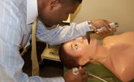
Teaching Requirements
Required for all faculty
Expectation ≥50 hours/year
Learners: students, residents, fellows, post docs, peers
Does not require teaching of students
Setting: classroom, clinical setting, lab…
Only Harvard associated teaching counts for 50 hours
HMS associated affiliates, HSPH, Harvard College…
Teaching outside of Harvard more reflective of reputation

Slide 12
Assistant vs. Associate Metrics
 | Assistant Professor | Associate Professor
Extent of Reputation | Local/Regional | Regional/National
Leadership roles | Local/Regional | Professional societies, grant review, consensus panels
Editorial roles | Ad hoc reviews | Editorial positions
Authorship | Some first author | Some senior author
Independence | May still be working under mentor | Evidence of independence from mentor

Slide 13
Assistant and Associate Professor Promotion Process
Hospital Department Process
Department Executive
Committee
HMS
Submission to Faculty Affairs
Review by P&R Committee
Review by the Dean’s Office
Review by the University
Notification of Department

Slide 14
What arrives at Faculty Affairs?
Letter from the Department Head
CV in the Harvard format
Letters of evaluation/support
Obtained by the Department Chair
At least 4 for assistant professor – at least 2 from HMS, 1 from outside HMS
At least 6 for associate professor – at least 2 from HMS, at least 2 from outside, one of which must be impartial
Two most significant scholarly contributions for assistant; five for associate

Slide 15
Review in the Office for Faculty Affairs
HMS sends an email to the faculty member
Promotion material has been received
Access to confidential web site
Review of the CV to be sure the format is correct and the essential information is present and clear
Department is contacted if changes needed
Search material present if needed
Confirm the number/ types of letters are appropriate

Slide 16
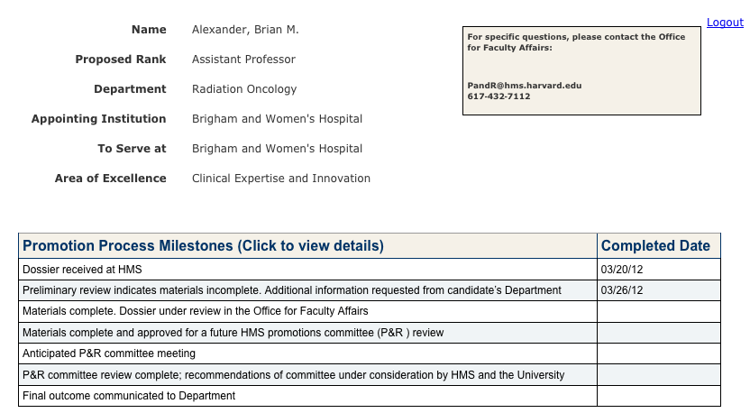
Promotions Milestone Website
01/01/10

Slide 17
P&R Process for Review of Candidates
Reviewers from different department & institution
Assistant candidates: Three reviewers
Vote ahead of meeting
If unanimously approved, not discussed at meeting
Two reviewers for associates and all discussed
Comments by the Department Representative
Committee discussion and vote
Recommendation advisory to the Dean

Slide 18
Longer Service Criteria
Committee established in 1999
Promotion for clinical faculty who have been instructors for at least 10 years
Evidence of substantial contributions and growth as a Clinician-Teacher
Teaching
Clinical practice and care
Citizenship/Leadership
No requirement for written scholarship
No requirement for external letters of evaluation (need 3 with at least 2 internal)

Slide 19
Longer Service FAQs
How will a Longer Service promotion affect my title?
Is this mechanism open to investigators?
What kind of teaching counts for Longer Service promotion?
What kind of clinical service counts for Longer Service promotion?
Can I go forward to Associate Professor?

Slide 20
Longer Service Review Process
Committee meets 5 times a year
Each case is reviewed by a member who is not in the candidate’s department or hospital
Committee discussion focuses on teaching and other contributions
Vote by secret ballot is advisory to the Dean

Slide 21
Final Steps for Both Promotion Pathways
Reviewed in the Dean’s Office
Sent to the Provost for review
Once approved by the Provost, the Department Head is notified
Department notifies the candidate
Promotion is dated the first day of the month it was reviewed by the committee

Slide 22
Most Common Reasons for Not Succeeding
Assistant Professor – P&R
Insufficient scholarship
Lack of recent scholarship
Inadequate teaching
Unsupportive letters
For investigators, no clear path to independence
Associate Professor – all of the above plus
Lack of a national reputation
Lack of independence from mentors
Insufficient teaching
Lack of innovation

Slide 23
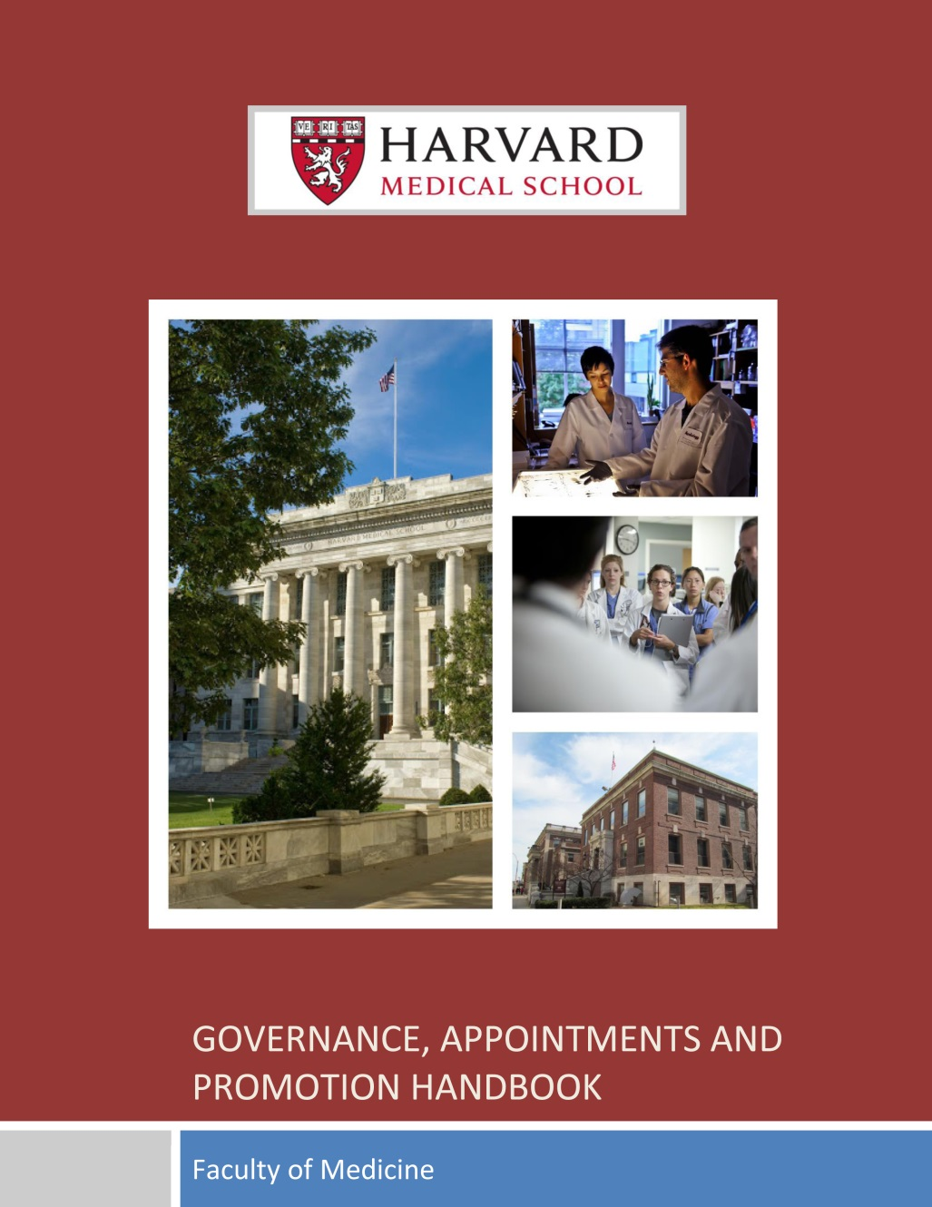
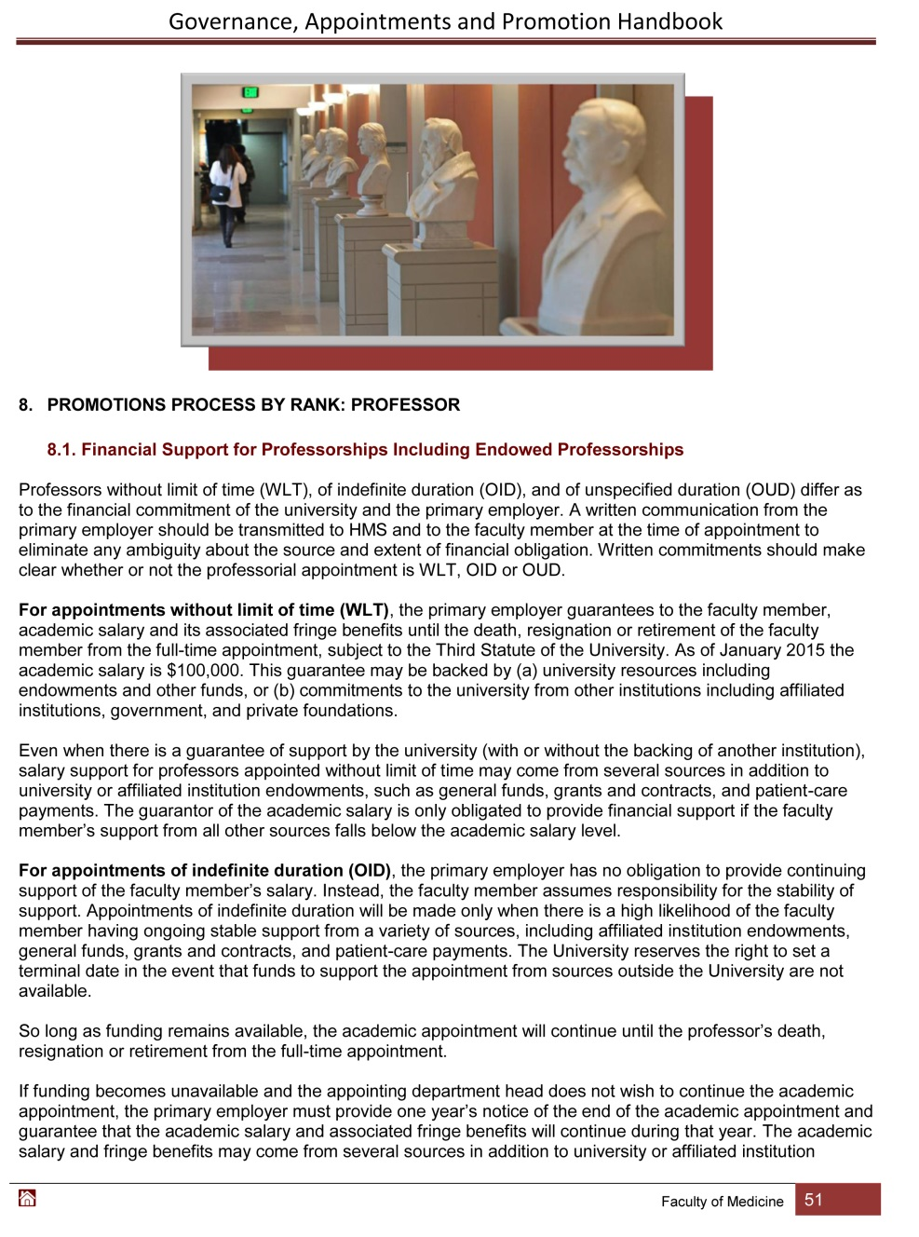

Slide 24
Part-time versus Full-time Titles
> 4 days per week: may be considered for a full-time ladder appointment (e.g., Associate Professor); may spend up to 1 of those 4 days working at an ‘affiliate of an affiliate’
1 to < 4 days per week: may be considered for a part-time ladder appointment (e.g., Associate Professor, Part-time) if at least 1 day at a primary affiliate
<1 day per week at a primary affiliate: Lecturer or Senior Lecturer
Exceptional pathway for global and community health roles

Slide 25
One man’s story…
John Enders (1897-1985)
Joined the HMS faculty in 1930 as an instructor
In 1954, he won the Nobel Prize in Physiology or Medicine for his discovery that polio virus could be grown in a variety of tissues, laying the groundwork for development of the polio vaccine
In 1956, he was promoted to Professor at Harvard Medical School

